Slide 1
Voice assistant
Using machine learning with python
By ADITYA(18bcs6656) , BINIT (18BCS6639) , SUMIT(18BCS6654) , SHIVAM (18BCS3054)

Slide 2
What is voice assistant :-
A voice assistant is a digital assistant that uses voice recognition, speech synthesis, and natural language processing (NLP) to provide a service through a particular application.

Slide 3
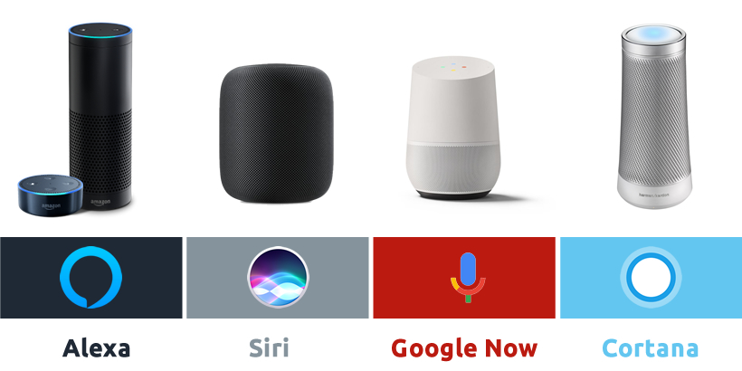
Example :-

Slide 4
Future of voice assistant :-
As AI becomes more advanced and voice technology becomes more accepted, not only will voice controlled digital assistants become more natural, they will also become more integrated into more daily devicesas it was estimated in early 2019 that 111.8 million people in the US will use a voice assistant at least monthly, up 9.5% from last year.

Slide 5
Services :-
Provide information such as weather, facts from e.g. Wikipedia or IMDb
Play videos, TV shows or movies on televisions, streaming
Assist public interactions with government

Slide 6
Drawback of voice assistant :-
Privacy
Accuracy

Slide 7
Thank you

